Slide 1


PANIMALAR ENGINEERING COLLEGE (An Autonomous Institution, Affiliated to Anna University) DEPARTMENT OF MECHANICAL ENGINEERING

Slide 2
About Us
An organization of the students, by the students and for the students

Slide 3
Drone Club Objectives
To create an awareness among students in the field of Drone technology and Drone piloting :
1. Enhance practical exposure to drone technology.
2. To train students in the field of Drone Piloting
3. Provide networking opportunities with professionals.

Slide 4
Faculty Coordinators
Dr. I. John Solomon, Asst Prof/ Mech
Dr. J. Gunasekeran, Asst Prof/ Mech

Slide 5
Student Coordinators
Chair – Mr. S Sagar (IV Year Mech)
Vice-Chair – Mr Hariharan S (IV Year Mech)
Secretary – Mr Ramsanjay V S (IV Year Mech)
Joint Secretaries – Keerthi Ramanan K M (III Year Mech)

Slide 6
Activities
Workshops
Hands on Training
Guest Lectures
Seminars
Expert Talks

Slide 7
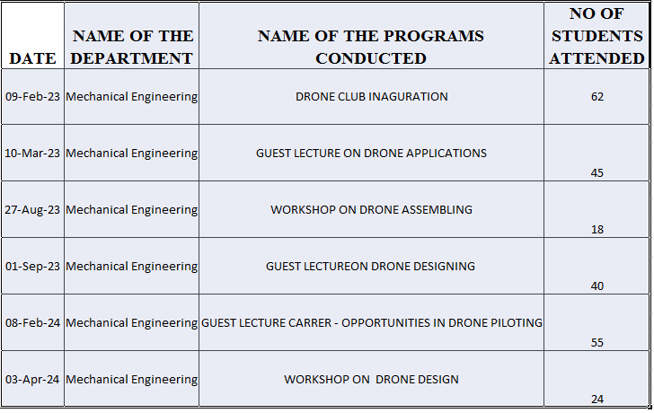
Programs Conducted

Slide 8
